Slide 1
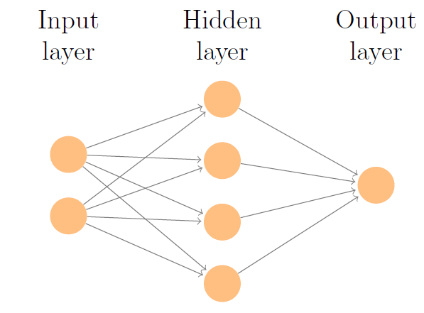
Review: Neural Network Model
A neural network consists of several layers:
Input Layer: (Raw) features
Hidden Layer(s): Each layer contains several artificial neurons
Output Layer: Our prediction

Slide 2
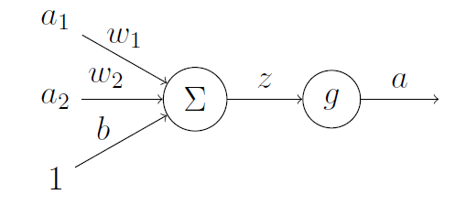
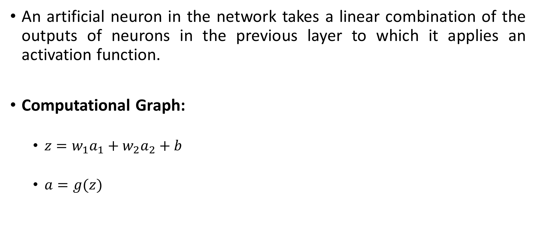
Review: Artificial Neuron
An artificial neuron in the network takes a linear combination of the outputs of neurons in the previous layer to which it applies an activation function.
Computational Graph:
$z=w_{1}a_{1}+w_{2}a_{2}+b$
$a=g(z)$

Slide 3
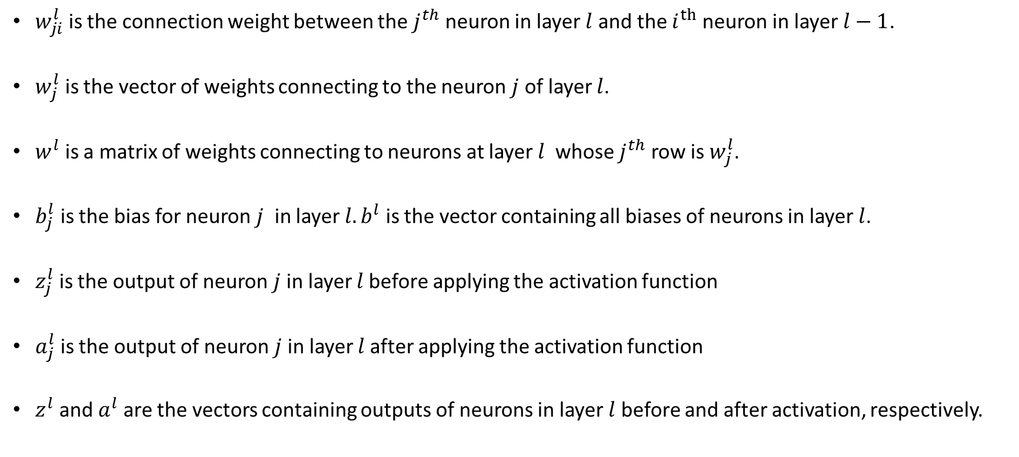
Review: Notations
$w_{ji}^{l}$ is the connection weight between the $j^{th}$ neuron in layer $l$ and the $i^{th}$ neuron in layer $l−1$.
$w_{j}^{l}$ is the vector of weights connecting to the neuron $j$ of layer $l$.
$w^{l}$ is a matrix of weights connecting to neurons at layer $l$ whose $j^{th}$ row is $w_{j}^{l}$.
$b_{j}^{l}$ is the bias for neuron $j$ in layer $l. b^{l}$ is the vector containing all biases of neurons in layer $l$.
$z_{j}^{l}$ is the output of neuron $j$in layer $l$before applying the activation function
$a_{j}^{l}$ is the output of neuron $j$in layer $l$after applying the activation function
$z^{l}$ and $a^{l}$ are the vectors containing outputs of neurons in layer $l$ before and after activation, respectively.

Slide 4
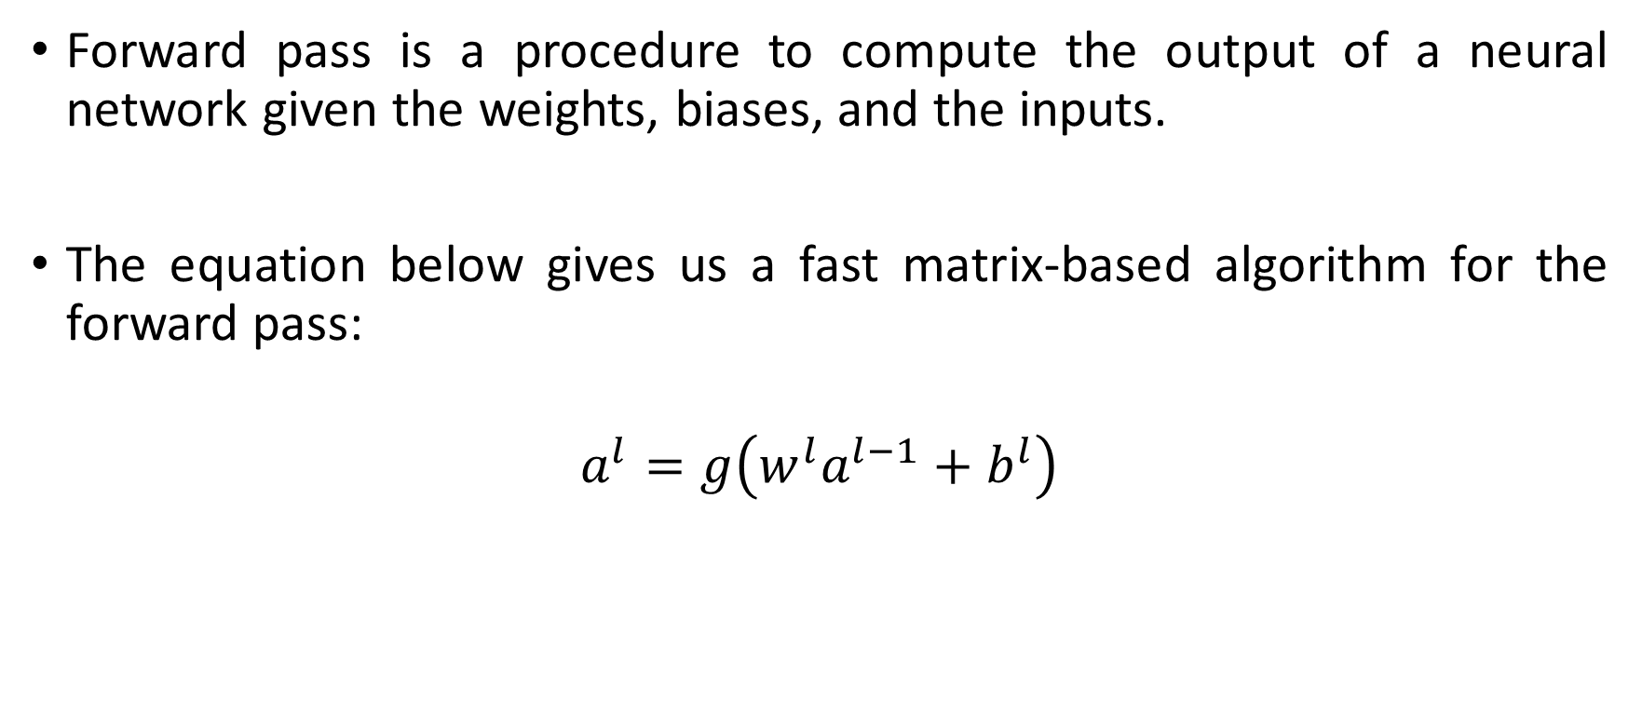
Review: Forward Pass
Forward pass is a procedure to compute the output of a neural network given the weights, biases, and the inputs.
The equation below gives us a fast matrix-based algorithm for the forward pass:
$$a^{l}=g\left(w^{l}a^{l−1}+b^{l}\right)$$

Slide 5
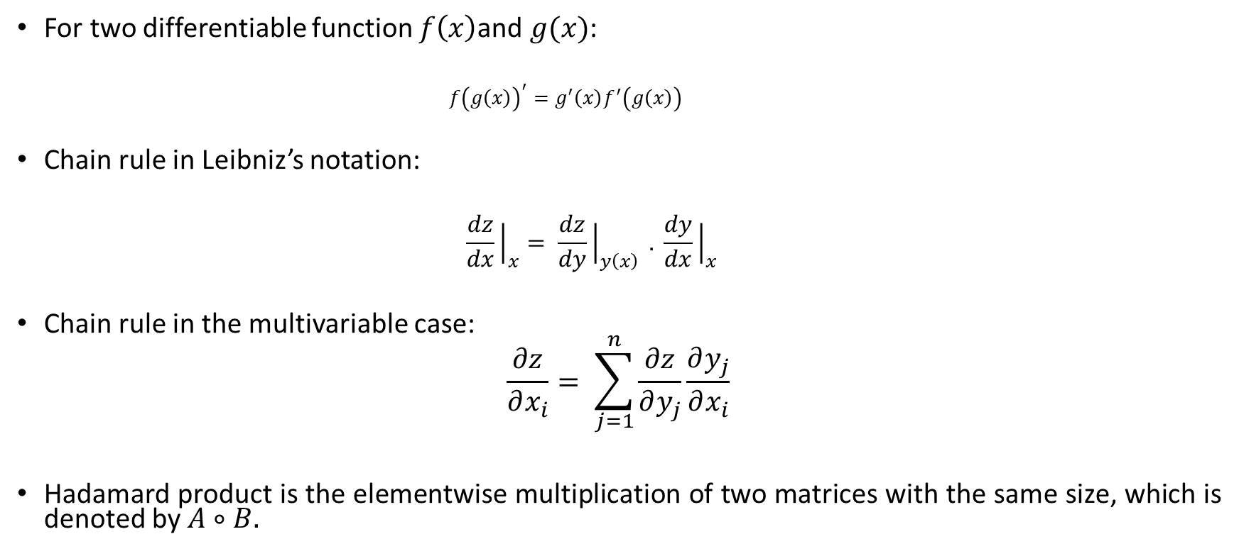
Review: Chain Rule and Hadamard Product
For two differentiable function $f\left(x\right)$and $g(x)$:
$$f{\left(g\left(x\right)\right)}^{′}=g^{′}\left(x\right)f^{′}\left(g\left(x\right)\right)$$
Chain rule in Leibniz’s notation:
$$\frac{dz}{dx}{\left.​\right|}_{x}= \frac{dz}{dy}{\left.​\right|}_{y\left(x\right)} . \frac{dy}{dx}{\left.​\right|}_{x}$$
Chain rule in the multivariable case:
$$\frac{∂z}{∂x_{i}}= \sum_{j=1}^{n}{\frac{∂z}{∂y_{j}}}\frac{∂y_{j}}{∂x_{i}}$$
Hadamard product is the elementwise multiplication of two matrices with the same size, which is denoted by $A∘B.$

Slide 6
Backpropagation
In backpropagation, we start at the end of the network, backpropagate or feed the errors back, recursively apply chain rule to compute gradients all the way to the inputs of the network and then update the weights.
This algorithm relies on four fundamental equations to find the gradient of the error function with respect to weights and biases.
Before each step of backpropagation, we need to have a forward pass in order to update the outputs of neurons.

Slide 7
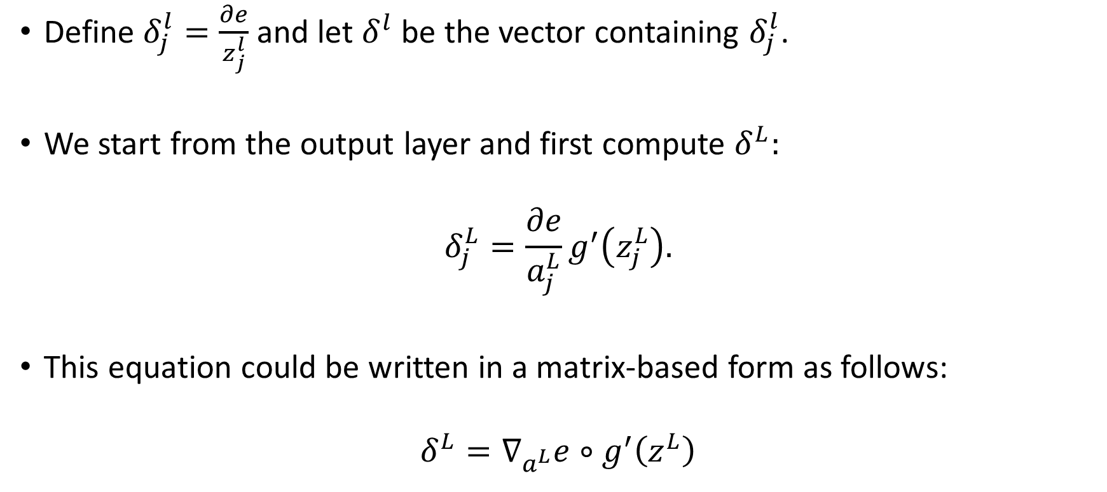
Implementing Backpropagation: Equation 1
Define $δ_{j}^{l}=\frac{∂e}{z_{j}^{l}}$ and let $δ^{l}$ be the vector containing $δ_{j}^{l}$.
We start from the output layer and first compute $δ^{L}:$
$$δ_{j}^{L}=\frac{∂e}{a_{j}^{L}}g^{′}\left(z_{j}^{L}\right).$$
This equation could be written in a matrix-based form as follows:
$$δ^{L}=∇_{a^{L}}e∘g^{′}\left(z^{L}\right)$$

Slide 8
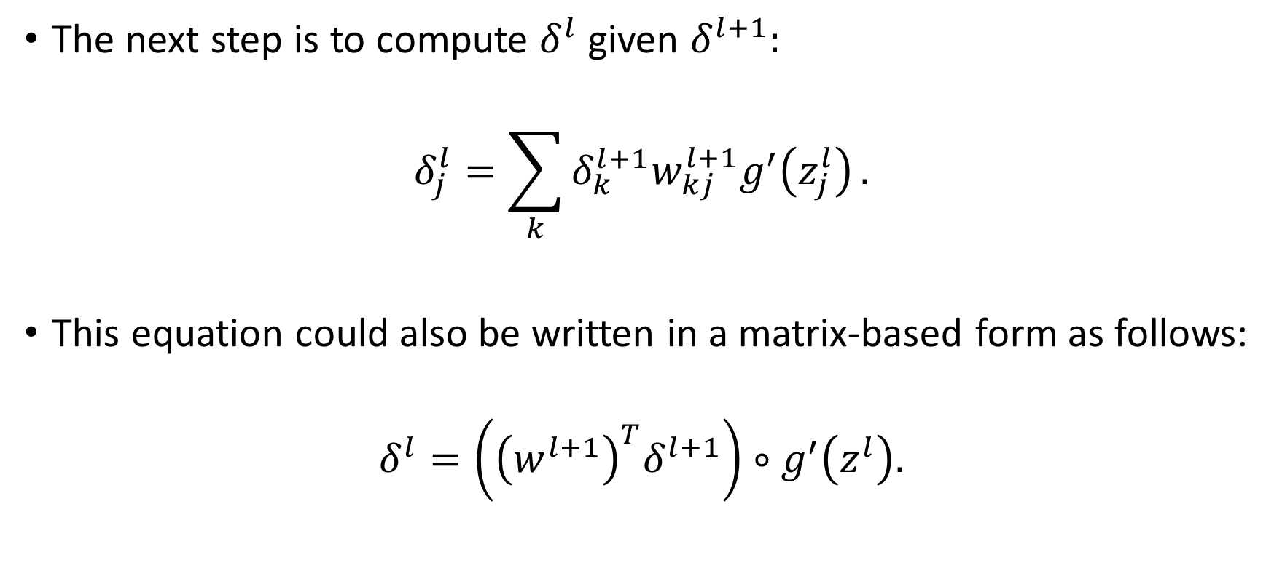
Implementing Backpropagation: Equation 2
The next step is to compute $δ^{l}$ given $δ^{l+1}:$
$$δ_{j}^{l}=\sum_{k}^{ }{δ_{k}^{l+1}w_{kj}^{l+1}g^{′}\left(z_{j}^{l}\right)}.$$
This equation could also be written in a matrix-based form as follows:
$$δ^{l}=\left({\left(w^{l+1}\right)}^{T}δ^{l+1}\right)∘g^{′}\left(z^{l}\right).$$

Slide 9
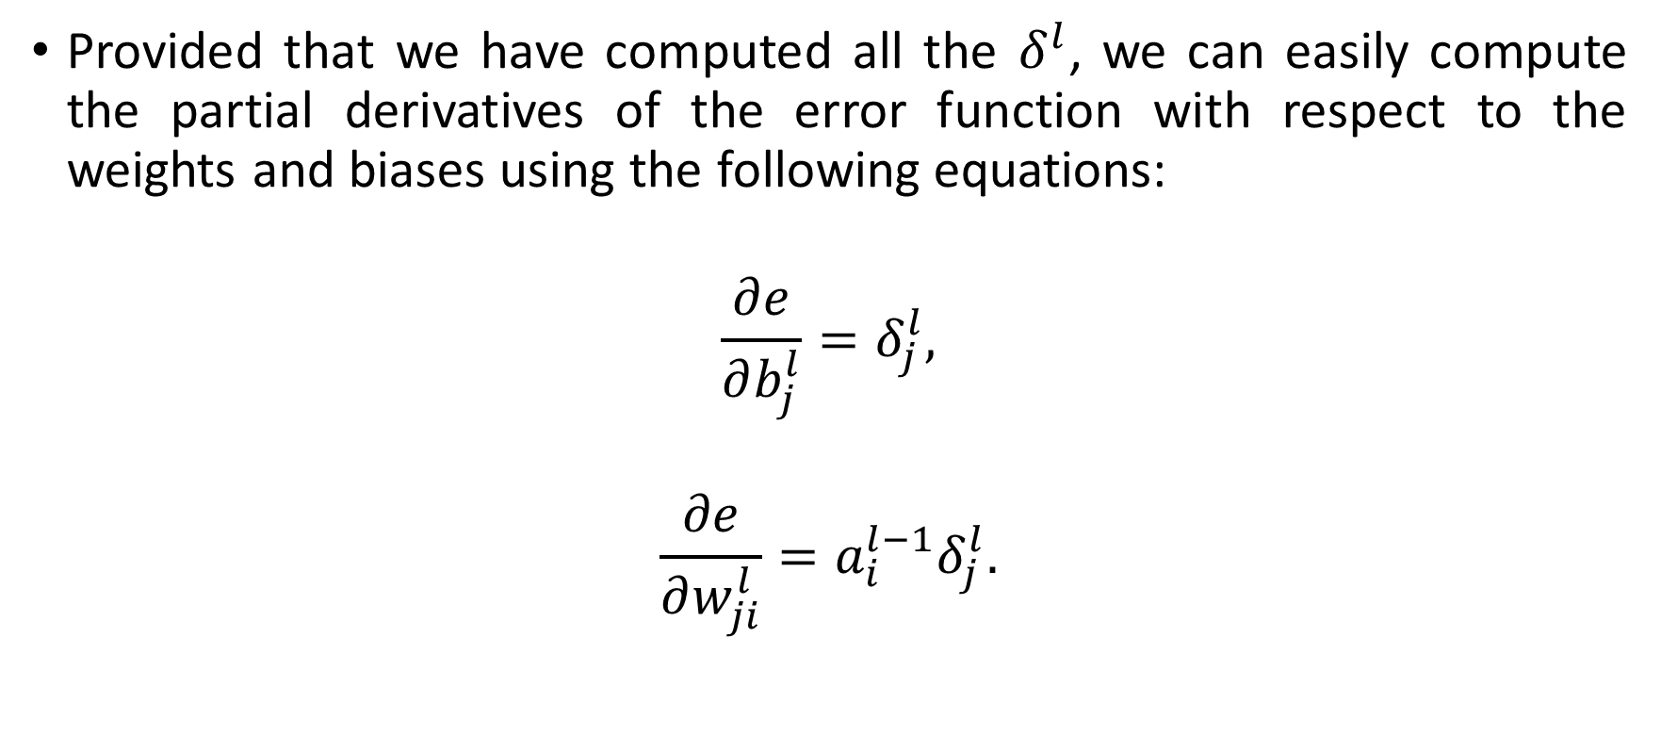
Implementing Backpropagation: Equations 3 and 4
Provided that we have computed all the $δ^{l}$, we can easily compute the partial derivatives of the error function with respect to the weights and biases using the following equations:
$$\frac{∂e}{∂b_{j}^{l}}=δ_{j}^{l},$$
$$\frac{∂e}{∂w_{ji}^{l}}=a_{i}^{l−1}δ_{j}^{l}.$$

Slide 10
What Are The Benefits of Backpropagation?
Computationally much cheaper than other alternatives such as finite differences.
Computes the exact partial derivatives, rather than just approximate them. This is indeed very important to prevent exploding gradients.
Exploding Gradients:
In deep neural networks, the error in gradient computation can accumulate during an update and result in very large gradients. These in turn result in large updates to the network weights, and in turn, an unstable network. At an extreme, the values of weights can become so large as to overflow and result in NaN values.

